Slide 1

Technology Entrepreneurship
Deb LJ Evans
Associate Professor
January 2017

Slide 2
YOU & your business idea
Market segments & value proposition
Marketing Strategy
Resources available
Operations plan
Resources needed
Risk &
strategic options
Financial plan

Slide 3

Market Gap Analysis
“There is no market for better mouse traps if mice are extinct”

Slide 4
Market Gap Analysis
Who needs it? Why?
What is the profile of a typical customer?
How many potential customers are there?
How many of those will buy? At what price?
How does this number change with price?
What are your potential customers’ top three key requirements? What are their concerns?
How will these customers buy your product (route to market)?
How will they find out about you?

Slide 5

SWOT Analysis
Use to analyse competition, business opportunities or new markets

Slide 6
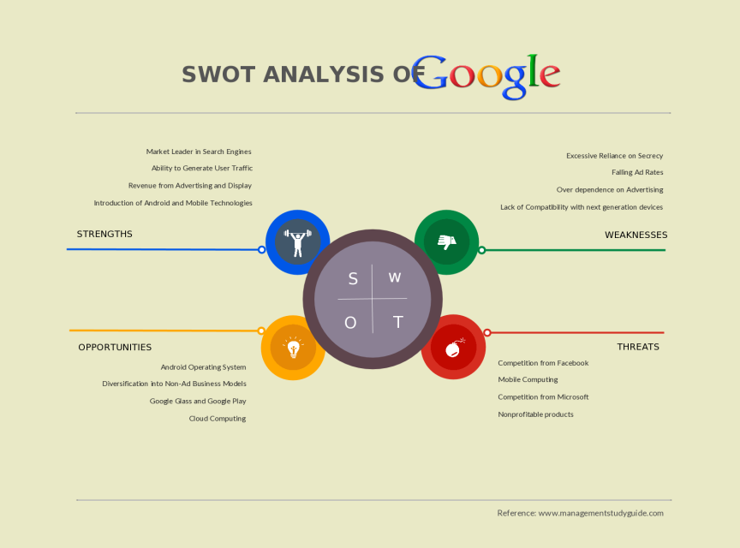
SWOT Analysis

Slide 7
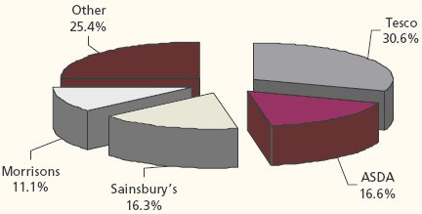
SWOT Analysis: TESCO Exercise
Fig 1: Share of Leading Players in UK Food Retail Market

Slide 8
Types of Business
Product or service
Product company does the same thing again and again
Service company, typically does things differently every day
Specialist or mass market
Brave new world, or better, faster, cheaper?

Slide 9
Business Models
Describe the rationale of how an organisation captures, creates and delivers value to its customers.
Highly used models:
direct sales
add-on (car insurance, flights)
Pay-as-you-go (mobile phones)
Recurring (broadband)
Low-cost (Ryanair)
Often models are combined

Slide 10

eBusiness Models

Slide 11


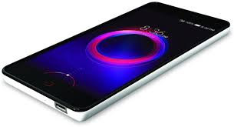

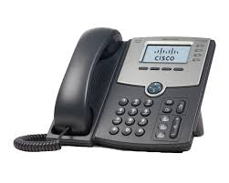

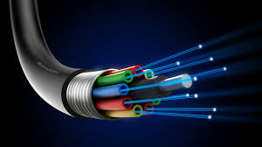
Telecommunications
Telecommunications, also known as telecom, is the exchange of information over significant distances by electronic means and refers to all types of voice, data and video transmission.

Slide 12


Telecoms networks
Internet
Corporate and academic WANs
Telephone networks
Mobile/cellular networks
Police and communication systems
Taxi despatch networks

Slide 13
IoT
Smart, connected products
21 billion ‘things’ connected to the internet by 2020
Wearable tech
Cloud
Home
Big data
Mobile
Smart cities
Health
Transport
Farming
Facilities management

Slide 14
IoT
Creating new value with data
Data sources
External data on prices, weather, supplier inventory, etc
Smart, connected products data on location, condition of use, etc.
Enterprise data on service histories, warranty status,etc.

Slide 15
IoT
A new era of ‘Lean’
“Smart, connected products will help make, people, materials, energy and plant and equipment far more productive, and the repercussions for business processes will be felt throughout the economy.” “Data flowing to and from products will allow product use and activities across the value chain to be streamlined in countless new ways, (Porter & Heppelmann, 2015).”

Slide 16
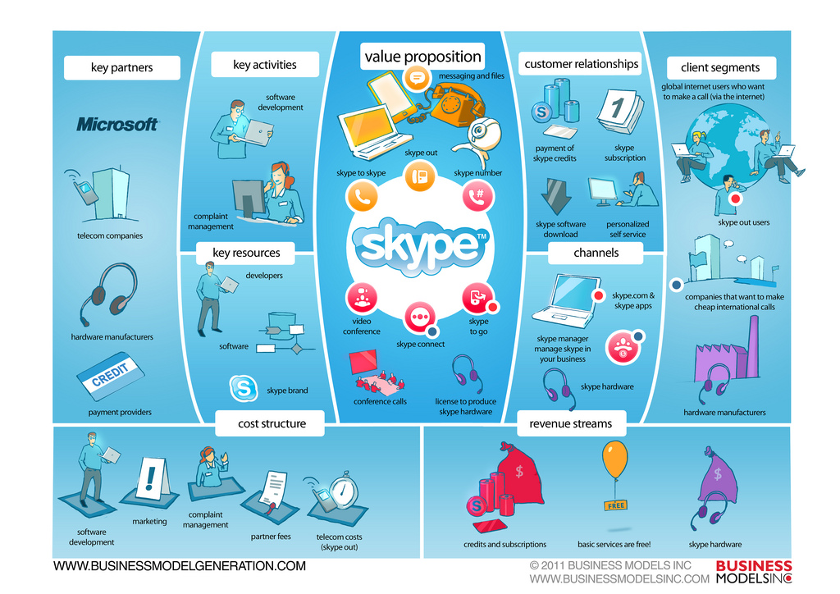

Slide 17
Need to refine or pin-down your business idea?

Slide 18
SWOT Analysis
Use to analyse competition, business opportunities or new markets

